Slide 1

_{APEX INSTITUTE OF TECHNOLOGY}
DEPARTMENT OF COMPUTER SCIENCE & ENGINEERING
Database Management System (22CSH-243)
_{Faculty: Ms. Shaveta Jain} _{(E13464)}
_{Cursor}
_{DISCOVER . LEARN . EMPOWER}

Slide 2
DBMS: Course Objectives
_{COURSE OBJECTIVES}
_{The Course aims to:}
Understand database system concepts and design databases for different applications and to acquire the knowledge on DBMS and RDBMS.
Implement and understand different types of DDL, DML and DCL statements.
Understand transaction concepts related to databases and recovery/backup techniques required for the proper storage of data.

Slide 3
COURSE OUTCOMES
On completion of this course, the students shall be able to:-
CO3 | Apply relational algebra and relational calculus to query the database of organization

Slide 4
Lecture Outline
Concept of Cursors
Implicit cursor
Explicit cursor

Slide 5
Cursors
Oracle creates a memory area, known as the context area, for processing an SQL statement, which contains all the information needed for processing the statement.
A cursor is a pointer to this context area.
PL/SQL controls the context area through a cursor.
A cursor holds the rows (one or more) returned by a SQL statement.
The set of rows the cursor holds is referred to as the active set.
In simple words, A cursor is a pointer that points to a result of a query.

Slide 6
Types of Cursor
There are two types of cursors:
Implicit cursors
Explicit cursors

Slide 7
Implicit cursors
Implicit cursors are automatically created by Oracle whenever an SQL statement is executed, when there is no explicit cursor for the statement.
Programmers cannot control the implicit cursors and the information in it.
Whenever Oracle executes an SQL statement such as SELECT INTO, INSERT, UPDATE, and DELETE, it automatically creates an implicit cursor.
Oracle internally manages the whole execution cycle of implicit cursors and reveals only the cursor’s information and statuses such as SQL%ROWCOUNT, SQL%ISOPEN, SQL%FOUND, and SQL%NOTFOUND.
The implicit cursor is not elegant when the query returns zero or multiple rows which cause NO_DATA_FOUND or TOO_MANY_ROWS exception respectively.

Slide 8
Write PL/SQL code to UPDATE values in created tables by using IMPLICIT CURSORS.
DECLARE
VAR_ROWS NUMBER(5);
BEGIN
UPDATE EMP SET SAL=SAL+100;
IF SQL%NOTFOUND THEN
DBMS_OUTPUT.PUT_LINE('NONE OF THE SALARIES WERE UPDATED');
ELSE IF SQL%FOUND THEN
VAR_ROWS:=SQL%ROWCOUNT;
DBMS_OUTPUT.PUT_LINE('SALARIES FOR'||VAR_ROWS||'EMPLOYEES ARE UPDATED');
END IF ;
END IF;
END;
/

Slide 9
Explicit cursors
Explicit cursors are programmer defined cursors for gaining more control over the context area.
An explicit cursor should be defined in the declaration section of the PL/SQL Block.
It is created on a SELECT Statement which returns more than one row.
Working with an explicit cursor involves four steps:
Declaring the cursor for initializing in the memory
Opening the cursor for allocating memory
Fetching the cursor for retrieving data
Closing the cursor to release allocated memory

Slide 10
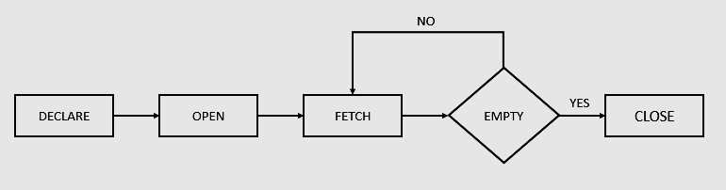
Oracle defines an execution cycle that executes an SQL statement and associates a cursor with it.
The following illustration shows the execution cycle of an explicit cursor:

Slide 11
Cursor Attribute
cursorname%ROWCOUNT :Rows returned so far
cursorname%FOUND :One or more rows retrieved
cursorname%NOTFOUND :No rows found
Cursorname%ISOPEN :Is the cursor open

Slide 12
Syntax:
DECLARE
CURSOR <cursor_name> IS <SELECT statement>;
cursor_variable declaration;
BEGIN
OPEN <cursor_name>;
FETCH <cursor_name> INTO <cursor_variable>;
.
.
CLOSE <cursor_name>;
END;/

Slide 13
Write PL/SQL code to display Employee details using EXPLICIT CURSORS.
DECLARE
CURSOR emp_cur IS SELECT * FROM EMP;
emp_rec EMP%ROWTYPE;
BEGIN
OPEN emp_cur;
LOOP
FETCH emp_cur INTO emp_rec;
EXIT WHEN emp_cur%NOTFOUND;
DBMS_OUTPUT.PUT_LINE(emp_rec.EMPNO||' '||emp_rec.ENAME||' '||emp_rec.SAL);
END LOOP;
CLOSE EMP_CUR;
END;/

Slide 14
PL/SQL Control Structure
DECLARE name varchar2(20);
Cursor c1 IS select t.name from table t where date is not null;
BEGIN
OPEN c1;
LOOP
FETCH c1 into name;
EXIT WHEN c1%NOTFOUND;
END LOOP;
CLOSE c1;
END;/

Slide 15
The %TYPE Attribute
Declare a variable according to:
• A database column definition
• Another previously declared variable
– Prefix %TYPE with:
• The database table and column
• The previously declared variable name

Slide 16
%TYPE (table.col%TYPE)
DECLARE vname emp.name%TYPE;
Cursor c1 IS select t.name from table t where date is not null;
BEGIN
OPEN c1;
LOOP
FETCH c1 into vname;
EXIT WHEN c1%NOTFOUND;
END LOOP;
CLOSE c1;
END;/

Slide 17
Write a procedure to retrieve the salary of a particular employee.
DECLARE
vid emp.eid%TYPE;
vsal EMP.SALARY%TYPE;
BEGIN
vid:='e101' ;
--vid = &vid ;
SELECT SALARY INTO vsal FROM EMP WHERE eid = vid;
DBMS_OUTPUT.PUT_LINE('SALARY OF '|| vid || ' IS '|| VSAL);
END;/

Slide 18
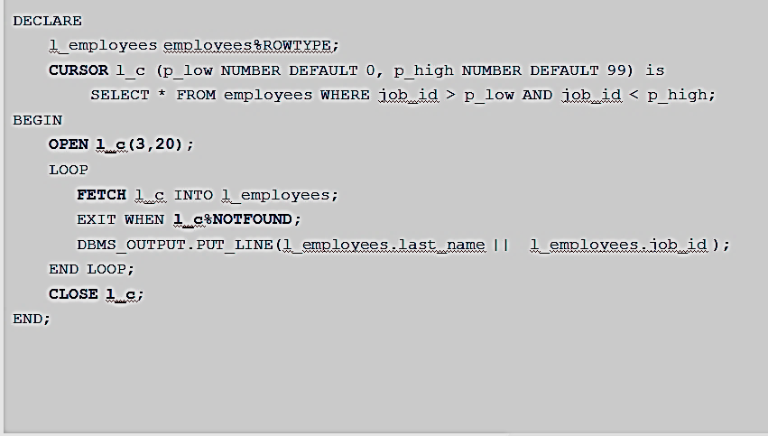
%ROWTYPE: Using Explicit Cursor

Slide 19
FAQs
Explain the concept of cursors
What is explicit cursor?
What is implicit cursor?
Explain %TYPE?

Slide 20
References
RamezElmasri and Shamkant B. Navathe, “Fundamentals of Database System”, The Benjamin / Cummings Publishing Co.
Korth and Silberschatz Abraham, “Database System Concepts”, McGraw Hall.
C.J.Date, “An Introduction to Database Systems”, Addison Wesley.
Thomas M. Connolly, Carolyn & E. Begg, “Database Systems: A Practical Approach to Design, Implementation and Management”, 5/E, University of Paisley, Addison-Wesley.

Slide 21
THANK YOU
For queries
Email: shaveta.e13464@cumail.in

